Slide 1


Model-based medical image analysis
Ela Claridge
School of Computer Science

Slide 2
Image formation

Slide 3
How digital images come into being?
Some theory ….

Slide 4
Image resolutions

Slide 5
Image resolutions

Slide 6
Image resolutions
Brightness
PSF
Point Spread Function

Slide 7

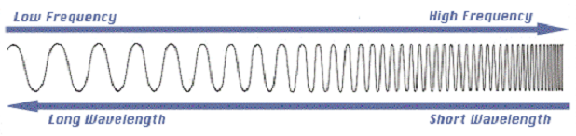
Spectral properties
Amplitude
800 nm = 3.8 x 10¹⁴ Hz
400 nm = 7.5 x 10¹⁴ Hz

Slide 8
Spectral properties
Reflected, transmitted or emitted light collected by a camera forms an image
Monochrome (B/W) – collects all visible light
Colour – three broad bands (RGB)
Multispectral – several – several tens of bands (broad or narrow)
Hyperspectral – many (hundreds) narrow bands

Slide 9
Spectral properties
RGB – broad-band filters
S(λ)
S(λ)
λ(nm)
λ(nm)
400
500
600
700
400
500
600
700

Slide 10
Spectral properties
Narrow-band filters
S(λ)
S(λ)
λ(nm)
λ(nm)
400
500
600
700
400
500
600
700

Slide 11
Image resolutions - Summary
Pixel
Spatial
Radiometric
Spectral
Temporal

Slide 12
What’s in the image data?

Slide 13

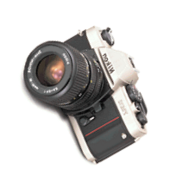
What’s in the image data?
Contributing factors
Light
Object
Imaging system

Slide 14
Reflected / remitted light (continuous)

Slide 15
Image acquisition

Slide 16
What’s in the image data?
Image data
Spectrum
i_{n}(x) =
∫
I₀(x,λ)
R(x,λ)
F_{n}(λ)
Q(λ)
dλ
Illuminant
Object reflectance
Filter Transmittance
Camera Quantum Efficiency

Slide 17
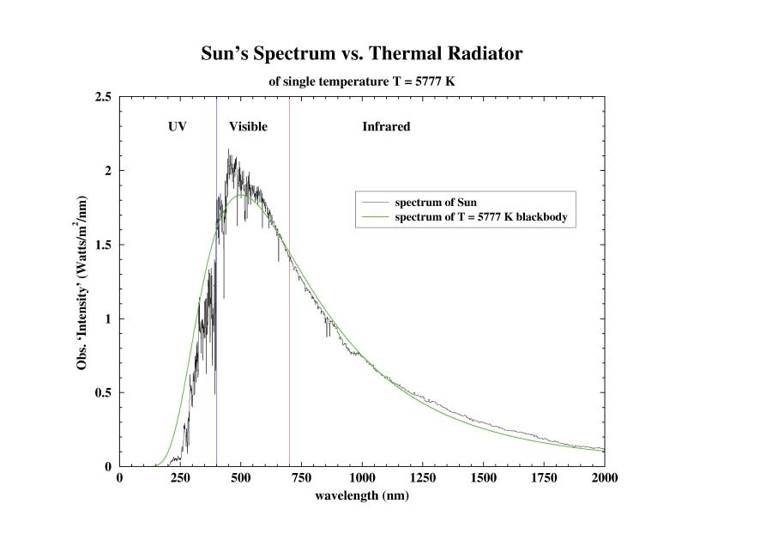
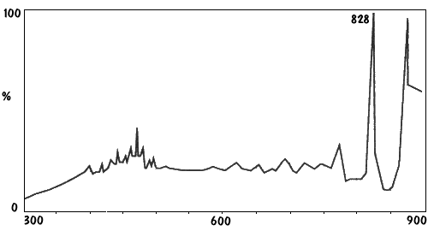
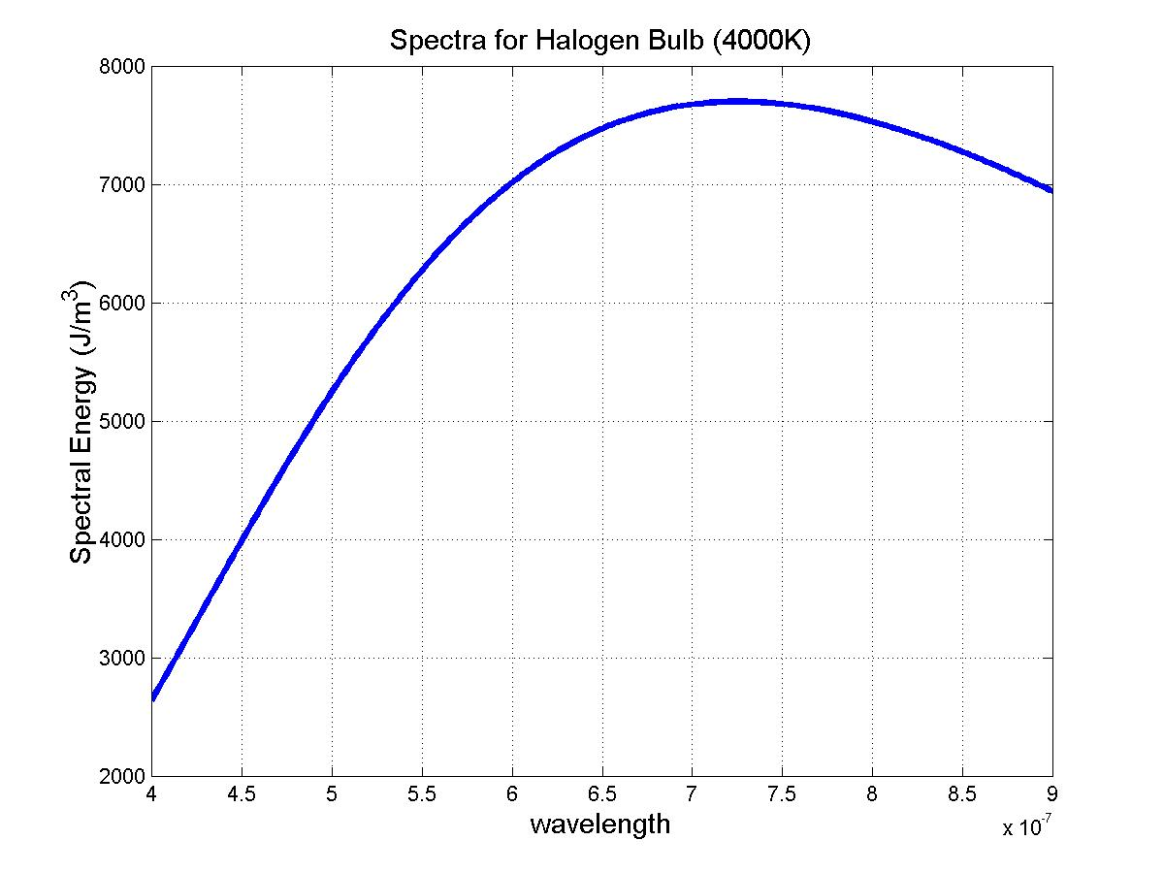
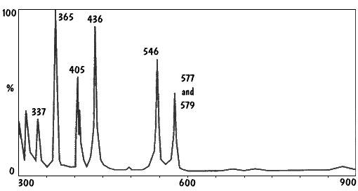
Spectra of common light sources
Daylight
Xenon
Mercury
Halogen

Slide 18
Imaging system
Quantum Efficiency
Filter
Transmittance
Image values recorded by the imaging device are affected by its optical properties, such as quantum efficiency

Slide 19
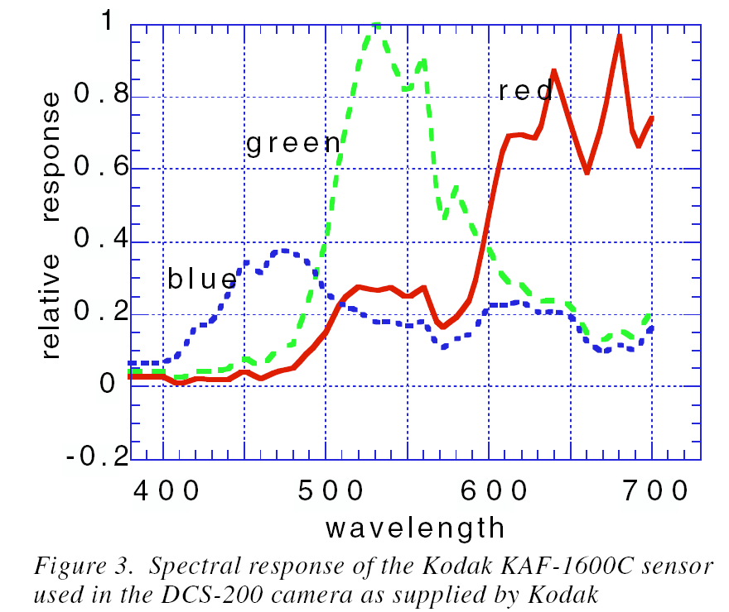
Spectral sensitivity (Quantum efficiency) curves for a colour camera

Slide 20
Imaging system: filters
A filter is a device which selectively transmits light having a particular range of wavelengths while blocking the remainder

Slide 21
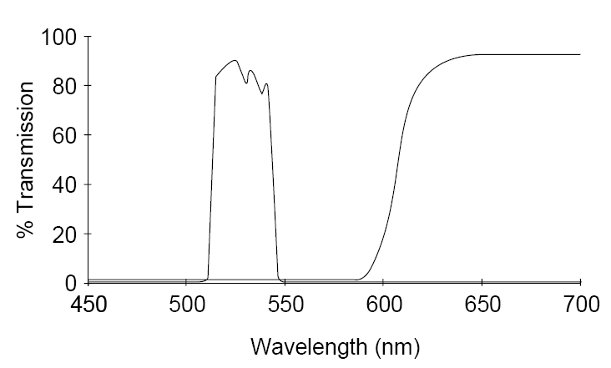
Imaging system: filters
Bandpass filter
Long-pass filter

Slide 22
Removing effects of the imaging system

Slide 23
What’s in the image data?
i_{n}(x) =
∫
I₀(x,λ)
R(x,λ)
F_{n}(λ)
Q(λ)
dλ
Illuminant
Object reflectance
Filter Transmittance
Camera Quantum Efficiency

Slide 24
Calibration
i_{n}(x) =
∫
I₀(x,λ)
R(x,λ)
F_{n}(λ)
Q(λ)
dλ
Measure I_{n}, Q_{n}, F_{n}
∫
I(λ)
dλ
I_{n} =
∫
Q(λ)
dλ
Q_{n} =
∫
F(λ)
dλ
F_{n} =
∫
R(x) = i_{n}(x) / (I_{n} ⋅ Q_{n} ⋅ F_{n})
(Also normalise for different exposure times)

Slide 25
Removing effects of the imaging system

Slide 26
Removing effects of the imaging system

Slide 27
Removing effects of the imaging system

Slide 28
Conclusion
We want to analyse tissue properties, not image properties!

Slide 29
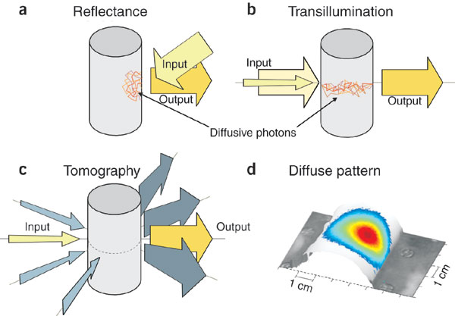

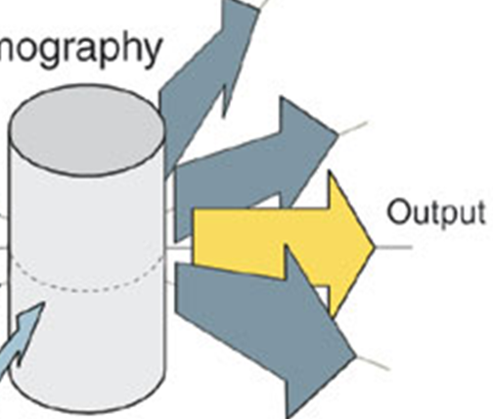
Diagnostic imaging
Emission
Looking and listening to light: the evolution of whole-body photonic imaging
Ntziachristos et al. Nature Biotechnology 23, 313 - 320 (2005)

